Slide 1

BMP: Literature Survey
January 27th, 2025
Mentor: Prof. Srimanta Mandal

Slide 2
Problem Statement
Given the rising attention^{[1]} on the mental health problems among youngsters with increased social media presence, we wanted to make the internet a safer and more productive place for everyone.
So, the goal is to create an interface that can curate existing content by blurring/removing hateful/abusive/non-child friendly content.
[1] – Australia’s ban on social media for teens under 16.
Following this, the Indian government enforced the requirement of parental consent strictly for usage of social media for teens.

Slide 3
Literature Survey
January 27th, 2025
Mentor: Prof. Srimanta Mandal

Slide 4
1. A Survey on Automatic Detection of Hate Speech in Text
1306 citations
ML models: SVM, Random Forest, Decision Trees, Logistic Regression, and Naive Bayes
CNN, DNN, LSTM
Text mining: N-grams, Bag-of-Words, TF-IDF, POS
Best F-measure (0.93) – combo of CNN, DNN, ML models
Average F-measure (0.77-0.9) – using traditional SVM

Slide 5
Name | Year | Classes Used | No. of instances | Language | Reference
Hate Speech Twitter annotations Hate Speech identification Abusive language dataset German Hatespeech Refugees Hatebase Hades Hate Speech and offensive language | 2016 2015 2016 2016 2017 2016 2017 | Sexist, racist Offensive with hate speech, offensive with no hate speech, not offensive Hate speech, not offensive Hate speech, not offensive - - - | 16,914 14,510 2,000 470 - - - | English English English German Universal Dutch English | Ref Ref Ref Ref Ref Ref Ref

Slide 6
2. Hate speech detection: Challenges and solutions
315 citations
Keywords - Hatebase
ML: SVM, Logistic Regression, Naive Bayes, NNs
DL: BERT, CNNs, GRU based ensembles
Text mining: N-grams, Bag-of-Words, TF-IDF, POS
BERT – 82 percent accuracy on Stormfront Neural Ensembles – 91.17% F1-score
mSVM: 53.68% F1, outperforming BERT (52.34% F1) and others.

Slide 7
Dataset | Model | Accuracy | Macro F1 | Reference
Stormfront | BERT | 0.8201 | 0.8201 | Ref
 | mSVM(ours) | 0.8033 | 0.8031 | Ref
TRAC(Facebook) | mSVM(ours) | 0.6121 | 0.5368 | Ref
 | BERT | 0.5809 | 0.5234 | Ref
Hatebase(Twitter) | Neural Ensemble | 0.9217 | 0.9118 | Ref
 | BERT | 0.9209 | 0.8917 | Ref
HatEval | BERT | 0.7480 | 0.7452 | Ref
 | Neural Ensemble | 0.7470 | 0.7481 | Ref

Slide 8
3. Detection of Hate Speech using BERT and Hate Speech Word Embedding with Deep Model
98 citations
Approach 1- Hate word embeddings with BiLSTM
Approach 2- Pre-trained BERT model
BiLSTM – 93% F1-score
BERT – 96% F1-score
(Both Results on combined dataset)

Slide 9
Methods | Datasets | P | R | f1-score (hate) | f1-score(non hate) | f1-score | AUC
BERT Base | Davidson-ICWSM | 0.96 | 0.96 | 0.98 | 0.89 | 0.962 | 0.9309
 | Waseem-EMNLP | 0.92 | 0.92 | 0.7654 | 0.9541 | 0.9216 | 0.8455
 | Waseem-NAACL | 0.85 | 0.85 | 0.7612 | 0.8881 | 0.8472 | 0.8227
 | Combined Balanced | 0.95 | 0.95 | 0.9543 | 0.9552 | 0.9547 | 0.9547
BERT Large | Davidson-ICWSM | 0.96 | 0.96 | 0.9788 | 0.8924 | 0.9646 | 0.9345
 | Waseem-EMNLP | 0.91 | 0.91 | 0.6939 | 0.9548 | 0.9103 | 0.8371
 | Waseem-NAACL | 0.85 | 0.85 | 0.7643 | 0.8937 | 0.8521 | 0.823
 | Combined Balanced | 0.96 | 0.96 | 0.962 | 0.9625 | 0.9623 | 0.9623

Slide 10
4. HateXplain: A Benchmark Dataset for Explainable Hate Speech Detection
599 citations
Data: Twitter and Gab scraping (total 20,148 posts)
Models: CNN-GRU (for local, sequential dependencies), BiRNN (bidirectional RNN), BiRNN with Attention (additional attention layer in model), BERT
69.8% accuracy, 68.7% Macro F1, 85.1% AUROC (due to diversity in dataset)

Slide 11
Model | Performance |  |  | Bias |  |  | Explainability
 | Acc | Macro F1 | AUROC | GMB-Sub | GMB-BPSN | GMP-BNSP | Plausibility IOU F1 Token F1 AUPRC |  |  | Faithfulness Comp Suff
CNN-GRU BiRNN(LIME) BiRNN-Attn(Attn) BiRNN(LIME) BiRNN-HateXplain(Attn) BiRNN-HateXplain(LIME) BERT(ATTN) BERT(LIME) BERT-HateXplain [Attn] BERT-HateXplain [LIME] | 0.627 0.595 0.621 0.621 0.629 0.629 0.690 0.690 0.698 0.698 | 0.606 0.575 0.614 0.614 0.629 0.629 0.674 0.674 0.687 0.687 | 0.793 0.767 0.795 0.795 0.805 0.805 0.843 0.843 0.851 0.851 | 0.654 0.640 0.653 0.653 0.691 0.691 0.762 0.762 0.807 0.807 | 0.623 0.604 0.662 0.662 0.636 0.636 0.709 0.709 0.745 0.745 | 0.659 0.671 0.668 0.668 0.674 0.674 0.757 0.757 0.763 0.763 | 0.167 0.162 0.167 0.162 0.222 0.174 0.130 0.118 0.120 0.112 | 0.385 0.361 0.369 0.386 0.506 0.407 0.497 0.468 0.411 0.452 | 0.648 0.605 0.643 0.650 0.841 0.685 0.778 0.747 0.626 0.722 | .316 .421 .278 .308 .281 .343 .447 .436 .424 .500 | -.082 -.061 .001 -.075 .039 -.075 .057 .008 .160 .004

Slide 12
5. Hate Speech Detection using Multi-channel BERT for Different Languages and Translations
Hajung Sohn, Hyunju Lee
Datasets - HatEval Spanish dataset, GermEval, HaSpeeDe Italian dataset BERTBASE used with 12 layers of encoders for the English BERT
MultiChannel BERT for Chinese

Slide 13
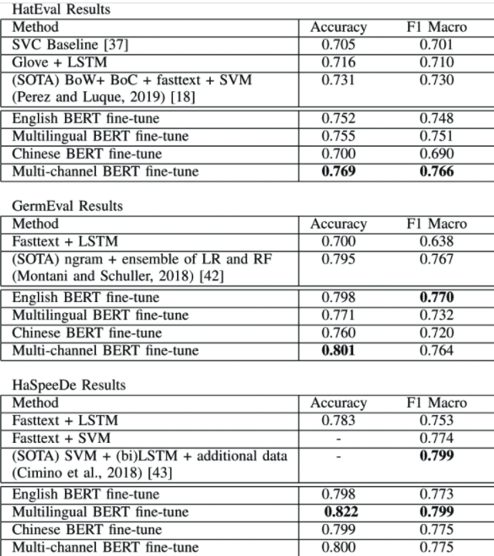

Slide 14
6. BERT-based Ensemble Approaches for Hate Speech Detection
Khouloud Mnassri, Praboda Rajapaksha, Reza Farahbakhsh, Noel Crespi
Datasets - 3 publicly available datasets:
Davidson
HatEval
OLID
The main contributions of this paper are:
1) Presenting transfer learning approach by integrating BERT with Multi Layers Perceptron (MLP), Convolutional Neural Networks (CNN) and Long short-term memory (LSTM) for hate speech detection, in order to explore this mix of models performs better in text classification tasks compared to neural networks or BERT alone.

Slide 15
